Slide 1


Championing health & wellbeing in the workplace
Zoe Temperton

Slide 2
“We’re already spending more on obesity-related healthcare costs than we are as a nation on the police, the fire service, prisons and the criminal justice system combined”
“This is not just a health issue we need to sort out – this is an economic necessity. We need to get much more serious as a nation about prevention and our own health.”
Simon Stevens, CEO of NHS England
Improving Wellbeing

Slide 3
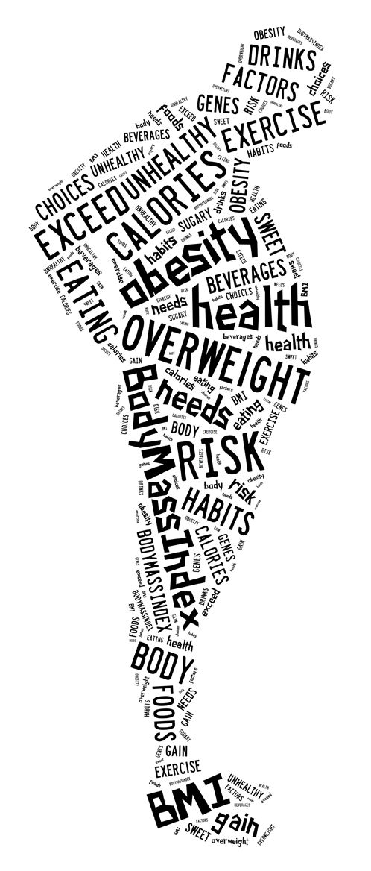
Our question to business…..
Are you doing enough?
Improving Wellbeing

Slide 4
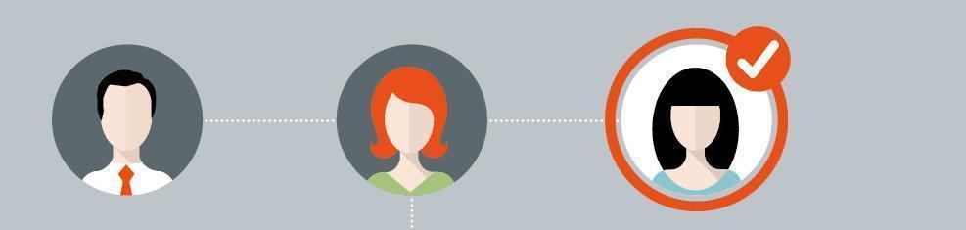
Does your organisaton have a holistic approach to health and wellbeing?
Do you know your hotspots?
What plans do you have in place?
How do you measure the health of your organisation?
Partnership working with healthcare provider

Slide 5
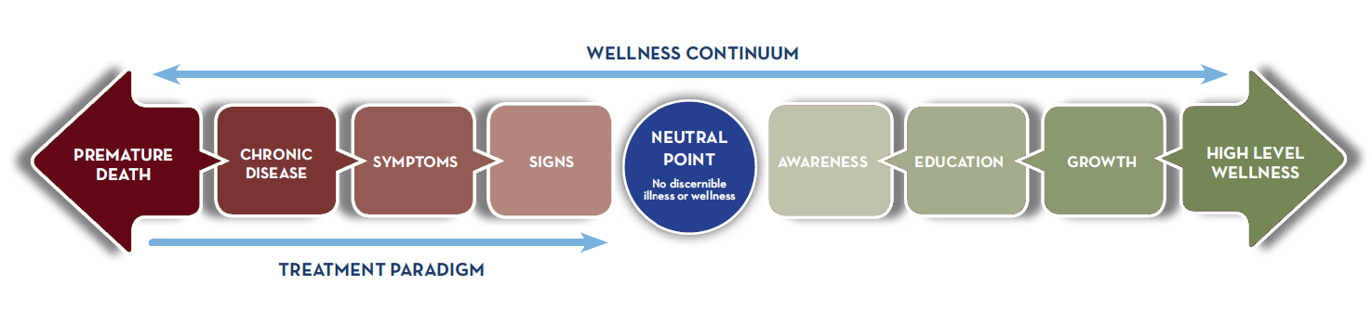
Where would you plot your team today?
HIGHER COST
LOWER PRODUCTIVITY
LOWER COST
HIGHER PRODUCTIVITY
Improving Wellbeing

Slide 6
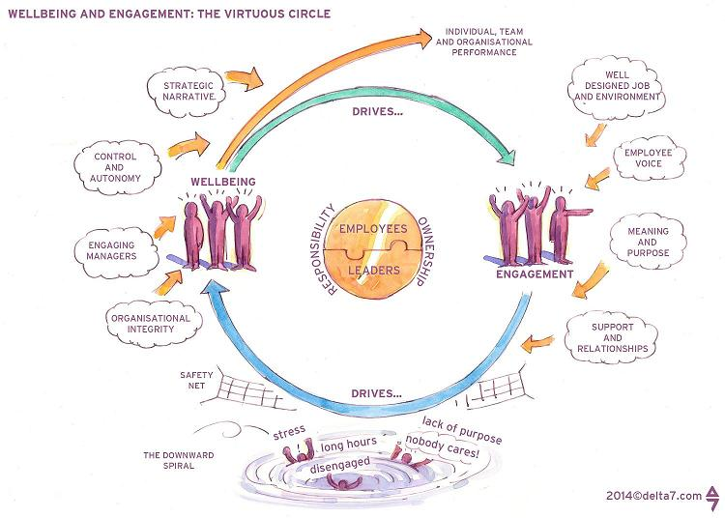
Wellbeing and Employee Engagement
Improving Wellbeing

Slide 7

Keeping the balance right
Improving Wellbeing

Slide 8
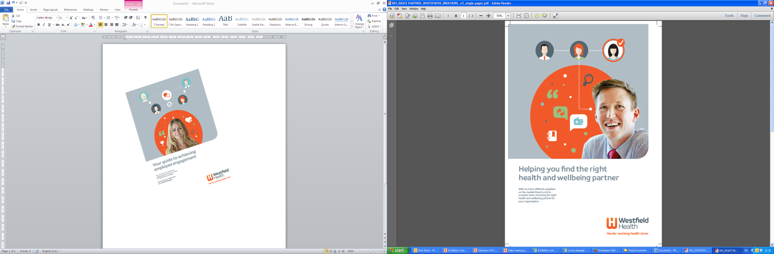
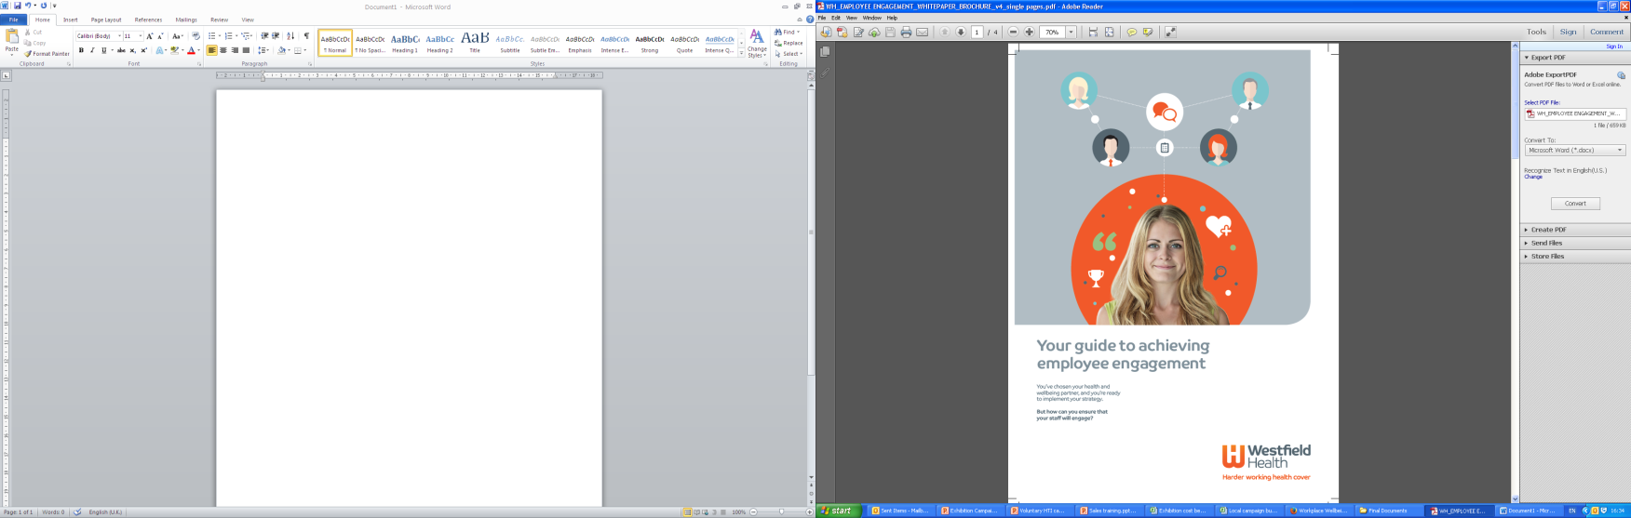
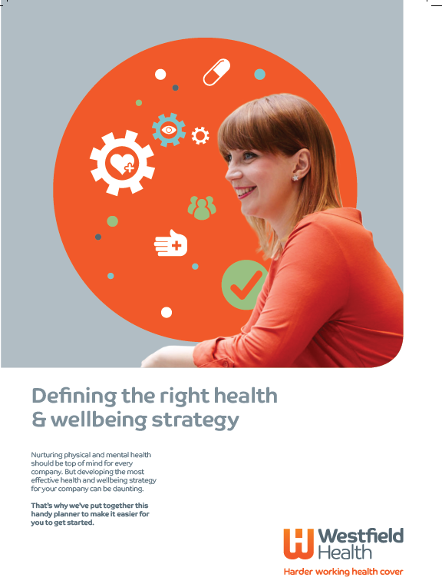
Where to start
Improving Wellbeing

Slide 9

Thank you
for listening
Improving Wellbeing

